Slide 1
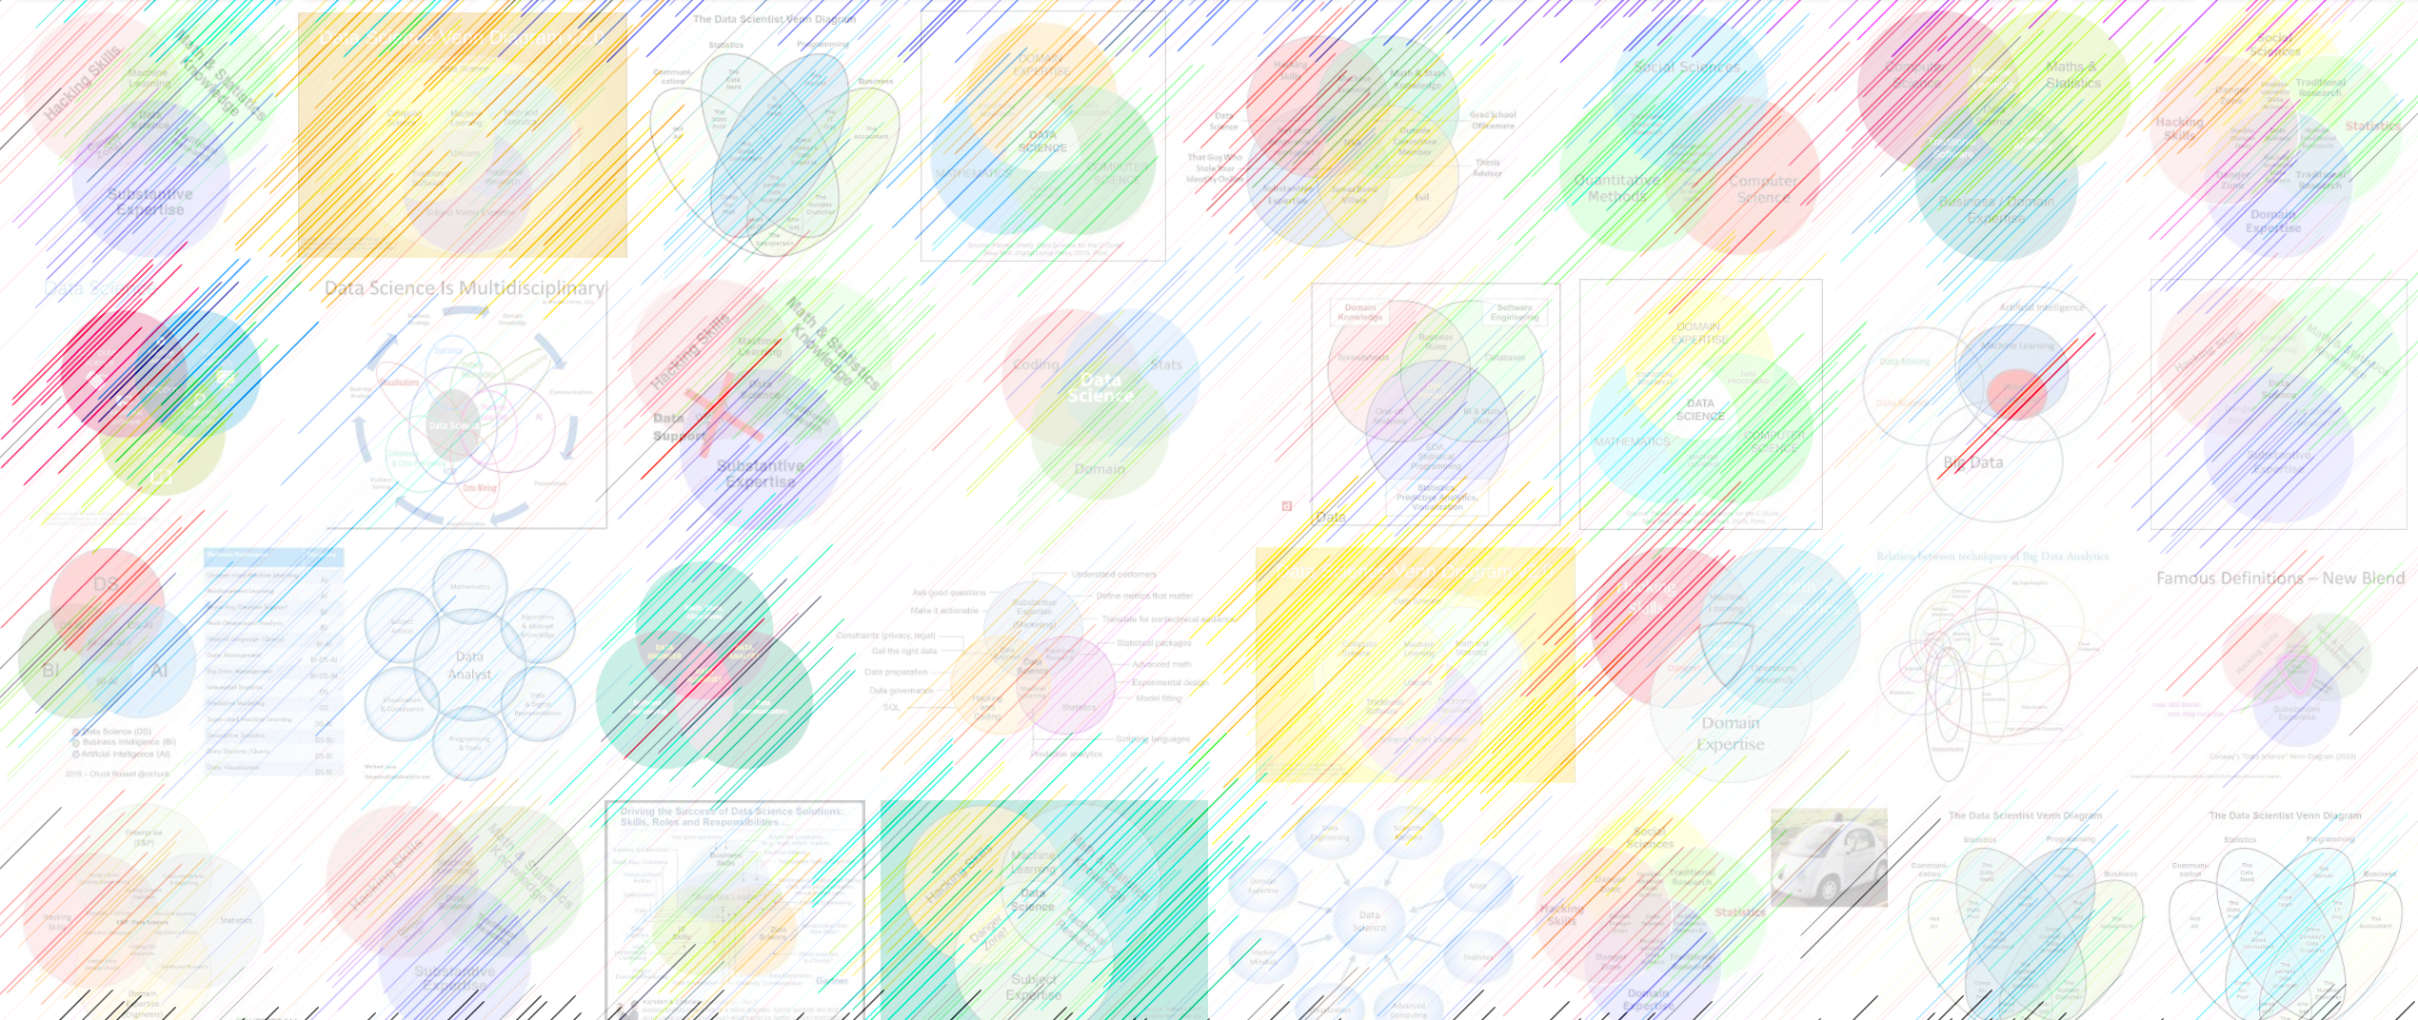

DATA221 Intro Machine Learning 13 Convolutional neural networks
William Trimble
Spring 2022

Slide 2
Office hours reminder
•office hours Monday 2pm (WT, zoom + Crerar 356)
•office hours Wednesday 2pm (Jiacheng, zoom)
•office hours Thursday 2pm (Sherry, zoom)
•office hours Friday 2pm (WT, Crerar 257)

Slide 3
Another attack is to add nonlinearity + layers
z = w^{T} X (implied sum over p)
$\hat{y}$ = f(z) (activation function)
L = Σ ($\hat{y}$ – y)² (implied sum over n)
w = argmax _{w} L( X, Y)
1
w₀
X₁
w₁
X₂
w₂
Σ
f
$$\hat{y}$$
w₃
X₃
w_{p}
X_{p}

Slide 4
Multilayer perceptron: Each ”neuron” applies a weighted sum + activation function
Input layer (p)
Hidden layer (n₁)
Hidden layer (n₂)
Output layer (d)
1
z₁
z₁
y₁
X₁
z₂
z₂
y₂
X₂
z₂
z₂
y₂
X₃
z₃
z₃
y_{d}
X_{r}
w (n₁ x r)
w (n₂ x n₁)
w (d x n₂)

Slide 5
ReLu activation ; linear or off
Input layer (p)
Hidden layer (n₁)
Hidden layer (n₂)
Output layer (d)
1
z₁
z₁
y₁
X₁
z₂
z₂
y₂
X₂
z₂
z₂
y₂
X₃
z₃
z₃
y_{d}
X_{r}
w (n₁ x r)
w (n₂ x n₁)
w (d x n₂)

Slide 6
Sigmoid and tanh activation functions: some of the nodes saturate high, some saturate low
Input layer (p)
Hidden layer (n₁)
Hidden layer (n₁)
Output layer (d)
1
z₁
z₁
y₁
X₁
z₂
z₂
y₂
X₂
z₂
z₂
y₂
X₃
z₃
z₃
y_{d}
X_{r}
w (n₁ x r)
w (n₂ x n₁)
w (d x n₂)

Slide 7
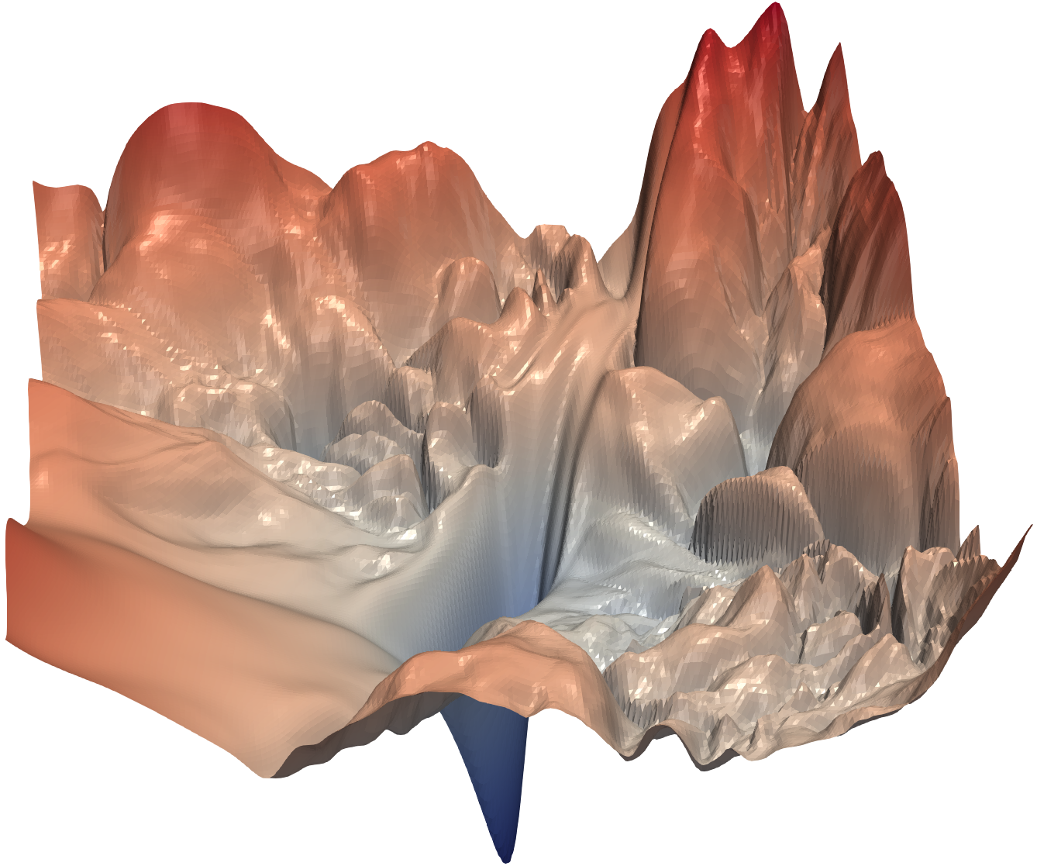
Randomly learning all the weights is hard
Li et al. NeurIPS 2018
Visualizing the Loss Landscape of Neural Nets

Slide 8
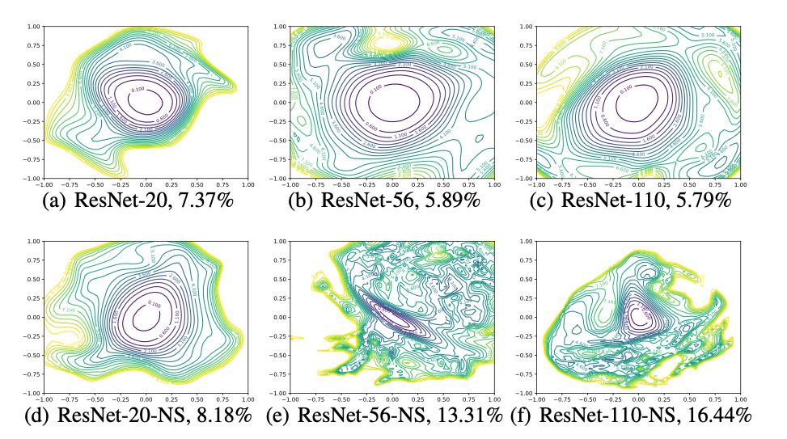

Slide 9
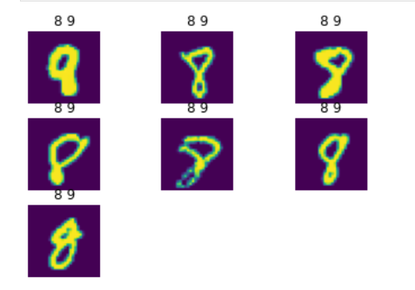
Convolutional Neural Networks
A fully-connected input layer does not “know” anything about pixel adjacency, except through the correlation of adjacent pixels in the design matrix X
The neural network has to learn everything that it will ever know about geometry from scratch.
“Convolutional networks are simply neural networks that use convolution in place of general matrix multiplication in at least one of their layers. “ - Ian Goodfellow
This limits the complexity of some of the early layers while exploiting symmetries (locality) in the input domain.

Slide 10
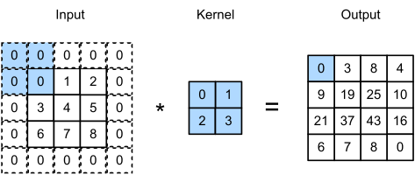
Convolution: inner product input with “kernel” at every possible offset
Convolution kernels are usually much smaller than the input data.

Slide 11
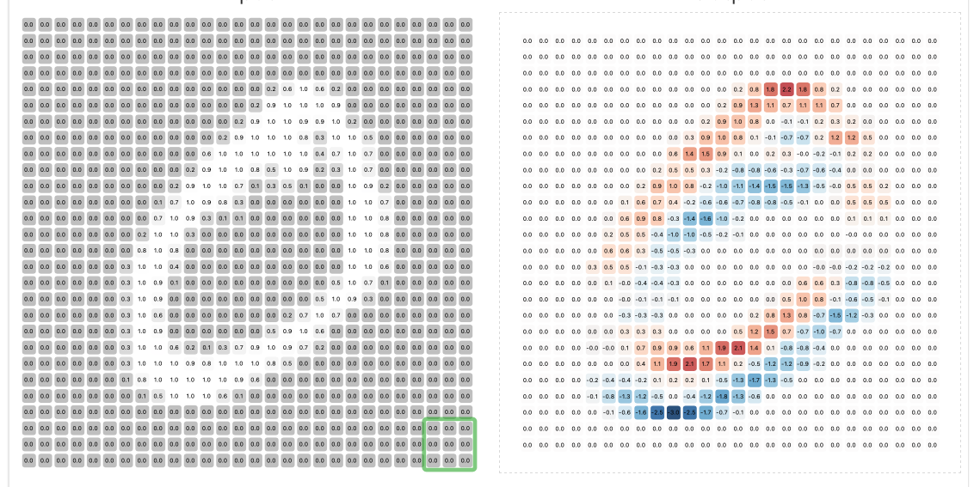
https://deeplizard.com/resource/pavq7noze2

Slide 12
Kernel activation
Because kernel/products are small, they can preserve most of the signal even after some distortions.
This will tend to make the solution that is found sensitive across a broader range of input variability (generalization is good)

Slide 13

Instead of fully-connected, use an ensemble of (initially random-kernel) convolution layers

Slide 14
CNN virtues:
Enforces sparse connectivity on input layers ( this makes the layers easier to train)
Parameter sharing: Weights in the input layers have effects on / can benefit / can benefit from data in the entire image; patterns learned in one part of the image will trigger the same neurons shifted to other parts of the image
Equivariance (symmetry preservation): Signals shifted by translations will trigger the same neurons because of the math, not because they have been trained to do so.

Slide 15
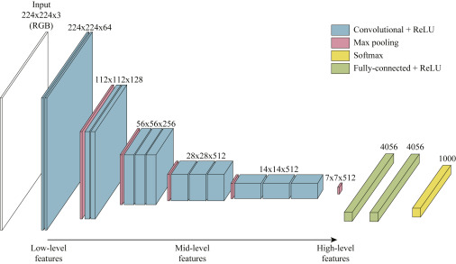
Later layers use results of convolution. Convolution kernels are subject to learning
Handful of other resolution-manipulating operations used along with convolution layers

Slide 16
